Slide 1
COMPUTER ORGANIZATION AND ARCHITECTURE
Dr. Rizwan Khan
Head – Department of Computer Science and Engineering
(An NBA Accredited Program)
ABES Institute of Technology, Ghaziabad

Slide 2
MAPPING
The mapping function determines how memory blocks are mapped to cache lines. This function sometimes is also referred to as the hashing function
This address conversion is done by giving special significance to the bits in the main memory address. We first divide the bits into distinct groups we call fields. Depending on the mapping scheme, we may have two or three fields. How we use these fields depends on the particular mapping scheme being used.
Main memory and cache are both divided into the same size blocks (the size of these blocks varies). When a memory address is generated, cache is searched first to see if the required word exists there. When the requested word is not found in cache, the entire main memory block in which the word resides is loaded into cache.
Direct Mapping: Specifies a single cache line for each memory block;
Set-Associative Mapping: Specifies a set of cache lines for each memory block;
Associative Mapping: No restrictions; any cache line can be used for any memory block.

Slide 3
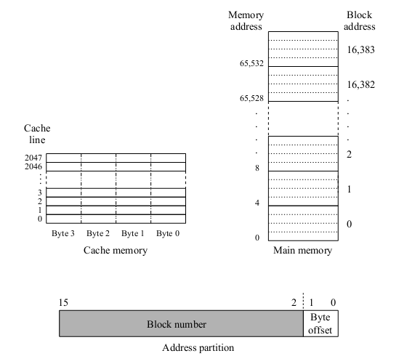
MAPPING

Slide 4
Cache mapping
Commonly used methods:
Associative Mapped Cache
Direct-Mapped Cache
Set-Associative Mapped Cache

Slide 5
Direct Mapping
Direct mapped cache assigns cache mappings using a modular approach. Because there are more main memory blocks than there are cache blocks, it should be clear that main memory blocks compete for cache locations. Direct mapping maps block X of main memory to block Y of cache, mod N, where N is the total number of blocks in cache. For example, if cache contains 10 blocks, then main memory block 0 maps to cache block 0, main memory block 1 maps to cache block 1, . . . , main memory block 9 maps to cache block 9, and main memory block 10 maps to cache block 0.
We are using a block size of 4 bytes so, no. of cache lines is 16/4=4.
E.g. memory block 11 is mapped to cache line 3 (11 mod 4)

Slide 6
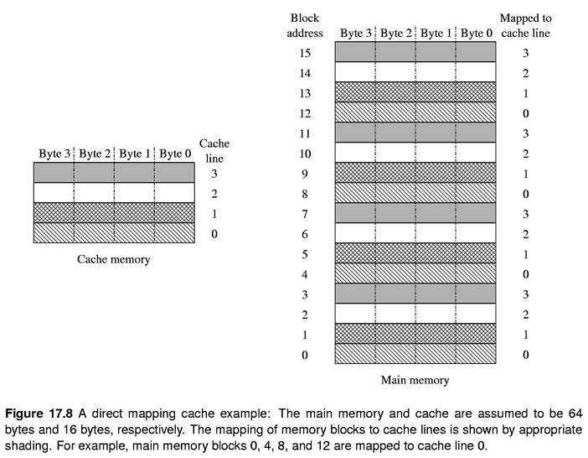
Direct Mapping

Slide 7
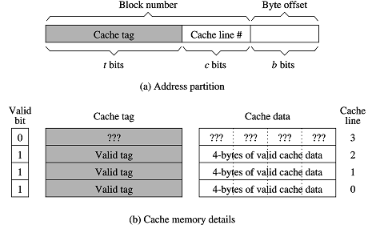
Mapping Function

Slide 8
Direct mapping (contd..)
Cache implementations maintain three pieces of information :
Cache Data: These are the actual data copied from the mapped memory block.
Cache Tag: Since more than one memory block is mapped to a cache line, we need to store the tag field for each cache line in order to know the address of the actual block stored. The size of the tag field t is equal to Log₂N, where N is the number blocks mapped to each cache line.
Valid Bit: We also need to store information on whether a cache line contains a valid block. This information is necessary so that we do not treat garbage as valid data. A single bit is sufficient to maintain this information. We use 1 to represent a valid cache line and 0 for an invalid cache line.
To find if a memory block is in the cache, use the modulo function to find the cache line for the block. Then check if the corresponding valid bit is 1. If so, compare the tag value stored at the cache line with the higher-order t bits of the memory block address. If there is a match, the required block is in the cache; otherwise, there is a cache miss.

Slide 9

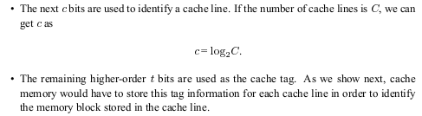
Direct Mapping

Slide 10
Example
B = Block Size = 16 words
C = Cache Size = 128 Blocks
M = Main Memory Size = 4K Blocks
Main Memory Address length = log ₂ (4Kx16) = 16 bits
Byte Offset b = log ₂ B = log ₂ 16 = log ₂ 2⁴ = 4 bits
Cache Line # c = log ₂ C = log ₂ 128 = log ₂ 2⁷ = 7 bits
Tag Bits t = Remaining Higher order bits = 16 – ( 4+7) = 5 bits
OR
Tag bits t = log ₂ (M/C) = log ₂ (2² x 2¹⁰ / 2⁷) = 5 bits

Slide 11
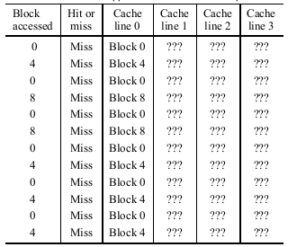
EXAMPLE
Example : Suppose that the reference pattern of a program is such that it accesses the following sequence of blocks: 0, 4, 0, 8, 0, 8, 0, 4, 0, 4, 0, 4. Find the hit ratio with a direct-mapped cache of four cache lines.
The three blocks accessed by the program—0, 4, and 8—are all mapped to cache line 0. When block 0 is accessed for the first time, it is placed in cache line 0. When the program accesses block 4 next, it replaces block 0 in cache line 0. You can continue this process and see that every block access leads to a cache miss. Thus the hit ratio is zero.
This example describes the worst-case behavior, where each access results in a miss. This scenario where a cache line is replaced before it is referenced again is called cache thrashing.

Slide 12
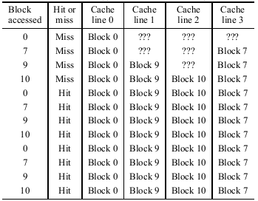
EXAMPLE
Example : Suppose the sequence of main memory blocks accessed is 0, 7, 9, 10, 0, 7, 9, 10,0, 7, 9, 10. Find the hit ratio in a direct-mapped cache with a cache size of four cache lines.
This reference pattern shows the best behavior. There will only be four cache misses. After these four blocks have been loaded into the cache, the remaining eight references can obtain data from the cache. Thus the hit ratio is 8/12 or about 67%. For this example, this is the maximum hit ratio one can obtain

Slide 13


